Slide 1
SECURE DATA HIDING IN IMAGES USING STEGANOGRAPHY
CAPSTONE PROJECT
Presented By:
Student Name : Ajay Vishwakarma
College Name & Department : Greater Noida Institute Of Technology
(BTech CSE)

Slide 2
OUTLINE
Problem Statement
Technology used
Wow factor
End users
Result
Conclusion
Git-hub Link
Future scope

Slide 3
Problem Statement
Design and develop a secure and efficient steganography system that can effectively hide sensitive information within digital images, ensuring confidentiality, integrity, and authenticity of the hidden data, while minimizing visual distortion and detection by unauthorized parties.

Slide 4
Technology used
Programming Languages
Python
Libraries
cv2 (OpenCV) for image processing-
os for interacting with the operating system
string for string manipulation
File Formats
JPEG
Operating Systems
Windows

Slide 5
Wow factors
Our steganography project is special because it has strong security, is fast, and easy to use. It hides secret messages in images, making it hard for others to detect. This makes it a great way to protect sensitive information.

Slide 6
End users
Government Agencies: For secure communication and data transfer.
Military Organizations: For covert operations and sensitive information sharing.
Law Enforcement Agencies: For investigating cybercrimes and protecting sensitive evidence.
Businesses and Corporations: For protecting intellectual property and sensitive business data.
Individuals: For personal use, such as protecting sensitive personal data or communicating securely with others.
Journalists and Whistleblowers: For securely sharing sensitive information and protecting sources.
Researchers and Scientists: For securely sharing sensitive research data and collaborating with others.
Financial Institutions: For protecting sensitive financial data and preventing cyber threats.

Slide 7
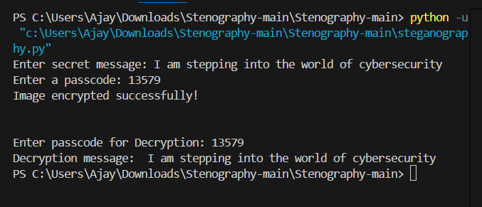
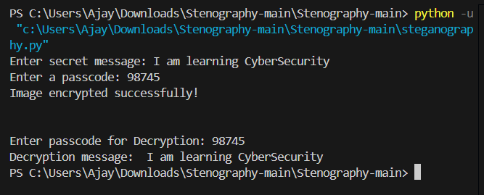
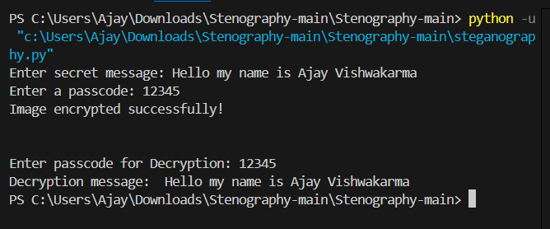
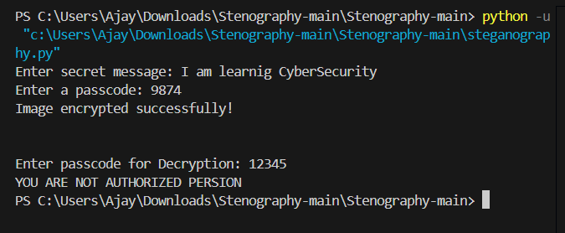
Results

Slide 8
Conclusion
The steganography project is complete, and it successfully hides secret messages in images. This project is important because it helps keep sensitive information safe from unauthorized access. With this technology, individuals and organizations can securely share confidential data. The project's success shows that steganography can be a powerful tool for protecting sensitive information. Future developments can make it even more secure and widely available. Overall, this project has achieved its goal of creating a secure and reliable steganography system.

Slide 9
GitHub Link
https://github.com/Ajay2309/Steganography.git

Slide 10
Future scope
The steganography project has a bright future. It can be used in cloud computing, IoT, and artificial intelligence. This will help secure sensitive data in healthcare, finance, and government. Future research will make steganography faster, more secure, and able to handle more data. It can also be combined with other security methods to create an unbeatable system. This project can change the way we secure and share sensitive information, making it safer and more reliable. Its possibilities are endless.

Slide 11
THANK YOU

